Slide 1
Backup and References
Scaffold Generation Methods:
NCATS R-group analysis (http://tripod.nih.gov/?p=46 )
Frameworks (Data-Driven Clustering, GSK/ChemAxon)
Scaffold Network Generator (http://swami.wustl.edu/sng)
Agglomerative Clustering (Complete Linkage, GSK/ChemAxon)
NCATS Scaffold Prioritization work:
http://www.slideshare.net/rguha/characterization-of-chemical-libraries-using-scaffolds-and-network-models
http://www.slideshare.net/rguha/prioritizing-scaffolds-for-hit-selection-in-high-throughput-screening-programs-2868540
They have been developing a workflow for doing what we need since ~2010 (see second presentation)
NCATS R–group tool @ http://tripod.nih.gov
G. Harper, G. S. Bravi, S. D. Pickett, J. Hussain, and D. V. S. Green. J. Chem. Inf. Comput. Sci., 44(6), 2145-2156 (2004)
M. K. Matlock, J.M. Zaretzki, and S. J. Swamidass. Bioinformatics. 29(20), 2655-2656 (2013).

Slide 2
Comparing Two Overlapping Ontologies: Method
Statistical methodology
Methods: A: Data-Driven Frameworks; B: R-Group Decomposition
Statistical measures calculated for each compound, X:
Frag_{A}, Frag_{B}: # fragments from A or B that X shares with other compounds
C_{A}, C_{B}: Set of compounds linked to X by these shared fragments
Fragment Efficiency: # compounds linked per fragment. Question: Which method is less wasteful in linking compounds?
Common Proportion: Ratio of size of Intersection(C_{A}, C_{B}) to Union(C_{A}, C_{B})
Question: “How similar are methods A and B for this molecule” ?
Proportion of Information Unique to A or B: PIU(A), PIU(B)
PI(A) = Ratio of size of C_{A} to Union(C_{A},C_{B}); proportion obtainable from A alone
PIU(A) = 1-PI(B); proportion unique to A
All these measures can be examined in aggregate (average), 5th/95th percentiles (outliers), or for individual compounds
D. Bandyopadhyay, J. Boyer and Z. He, building on the method of Torres et al. (2009) Int. J. Elect. Comp. Sys.

Slide 3
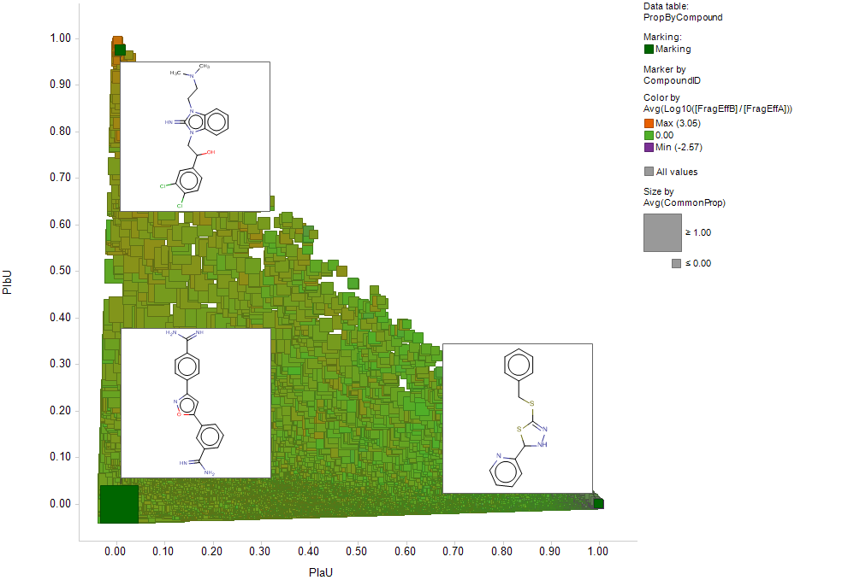
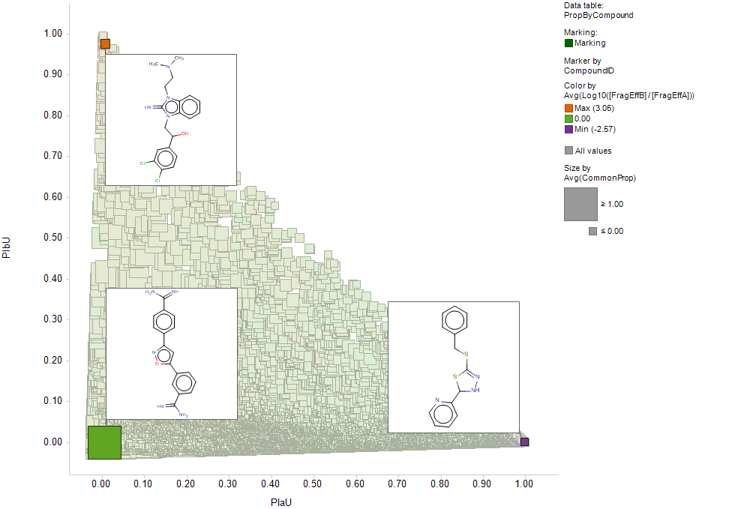
Frameworks(A), RGDecomp(B) link to different compds
Overlap varies from none to total; on average RGD is more efficient
Fragment Efficiency of RGDecomp (B) much greater than Frameworks (A):
Minor tautomer, unified by RGDecomp
Fragment Efficiency of RGDecomp (B) much less than Frameworks (A):
Inclusion of benzene ring as framework
Similar
efficiency:
almost
complete
overlap in
linked
compounds
Notes:
Stats:
The two methods allow you to access different sets of molecules starting from any molecule in TCAMS (average overlap in coverage is 40%).
On the aggregate (average/median), you can link to about twice as many molecules with the frameworks, however, this is because on the aggregate there are 6 times more frameworks than NCATS scaffolds, so the “fragment efficiency” is actually 3 times greater for NCATS scaffolds. One could also argue that many of the framework-only links (eg. variously decorated benzene rings) are not useful.
The outliers are interesting: compounds in a rare tautomer are unified with the dominant one by the NCATS tool, but left as singletons by the frameworks. And compounds whose only link with other molecules would be eg. a benzene ring remain singletons with the R-group tool.

Slide 4
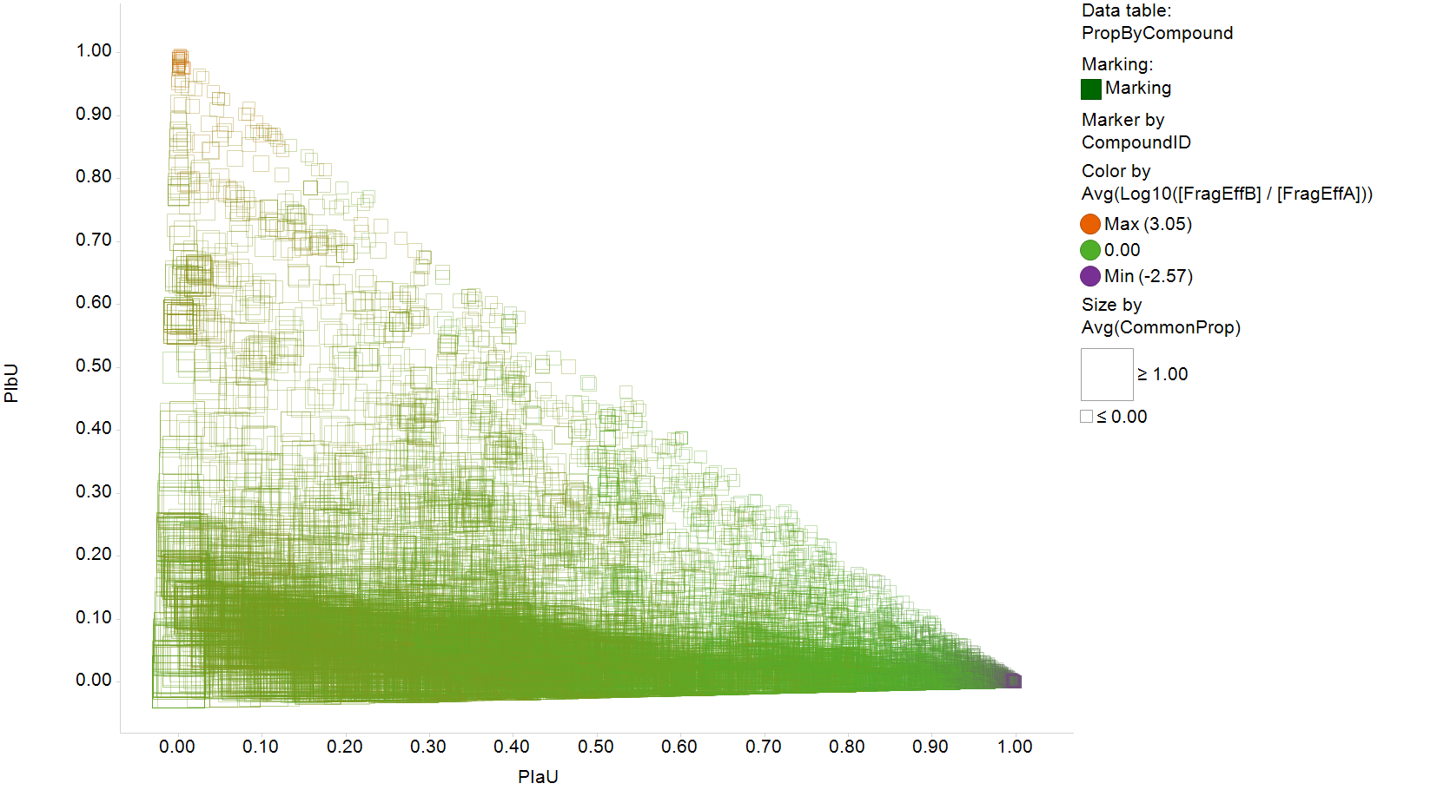
Frameworks(A), RGDecomp(B) link to different compds
Fragment Efficiency of RGDecomp (B) greater than Frameworks (A):
Minor tautomer, unified by RGDecomp
Similar
efficiency:
almost
complete
overlap in
linked
compounds
Fragment Efficiency of RGDecomp (B) less than Frameworks (A):
Inclusion of fragments attached to benzene ring as Frameworks
Notes:
Stats:
The two methods allow you to access different sets of molecules starting from any molecule in TCAMS (average overlap in coverage is 40%).
On the aggregate (average/median), you can link to about twice as many molecules with the frameworks, however, this is because on the aggregate there are 6 times more frameworks than NCATS scaffolds, so the “fragment efficiency” is actually 3 times greater for NCATS scaffolds. One could also argue that many of the framework-only links (eg. variously decorated benzene rings) are not useful.
The outliers are interesting: compounds in a rare tautomer are unified with the dominant one by the NCATS tool, but left as singletons by the frameworks. And compounds whose only link with other molecules would be eg. a benzene ring remain singletons with the R-group tool.

